Slide 1
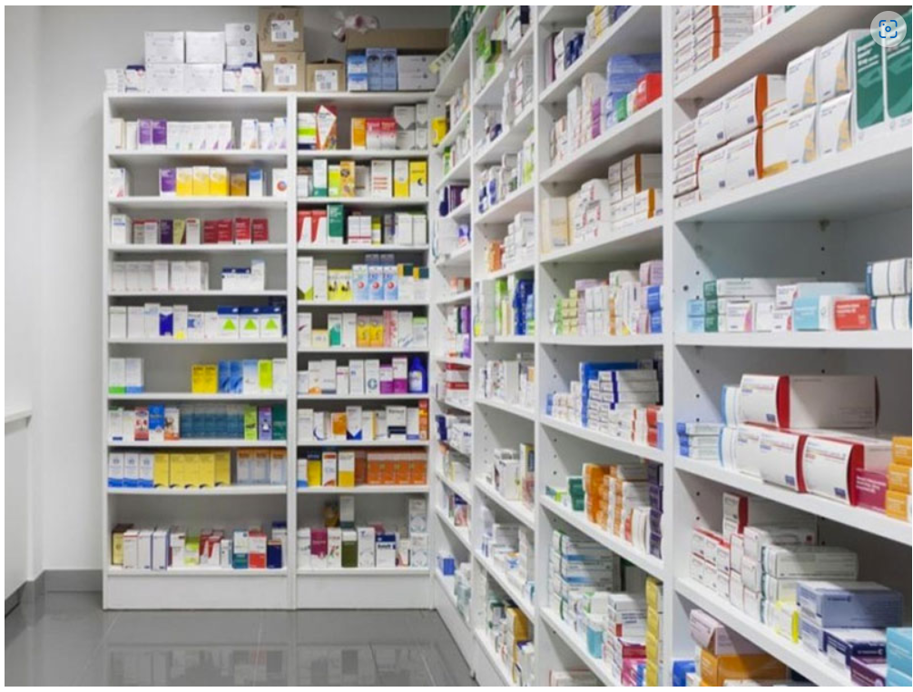

Pharmaceutical Sales prediction across multiple stores
ASHA SANDEEP
NOIDA
DIGICHROME ACADEMY
Project-6
submission date:-3-11-2024
To Nexthikes@info.

Slide 2
OBJECTIVE
To forecast sales in all their stores across several cities six weeks ahead of time. Managers in individual stores rely on their years of experience
as well as their personal judgement to forecast sales .

Slide 3
Project statement
Pharmaceutical companies often face challenges in inventory management and demand forecasting due to fluctuations in sales influenced by various factors (e.g., promotions, holidays, seasons, product availability). Effective sales prediction is crucial to minimize stockouts or overstock situations.

Slide 4
Solution
I got the solution from google and geeks for geeks .

Slide 5
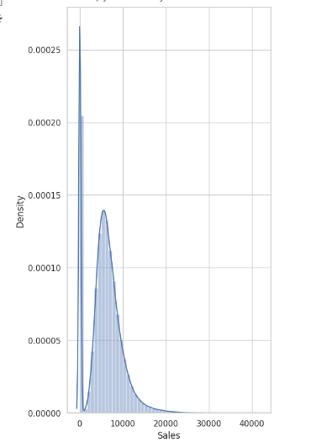
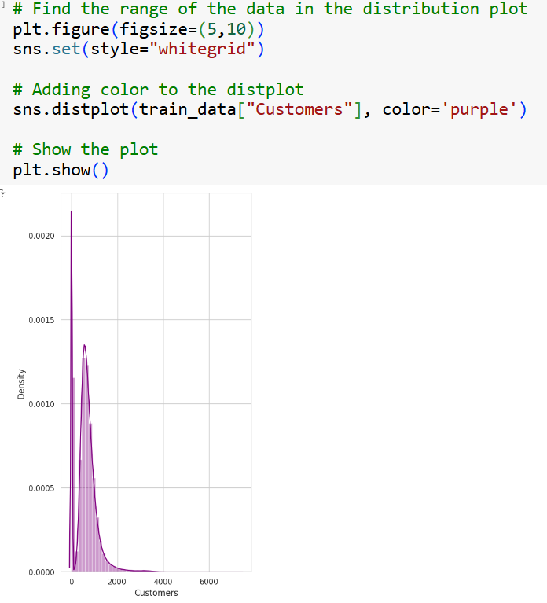
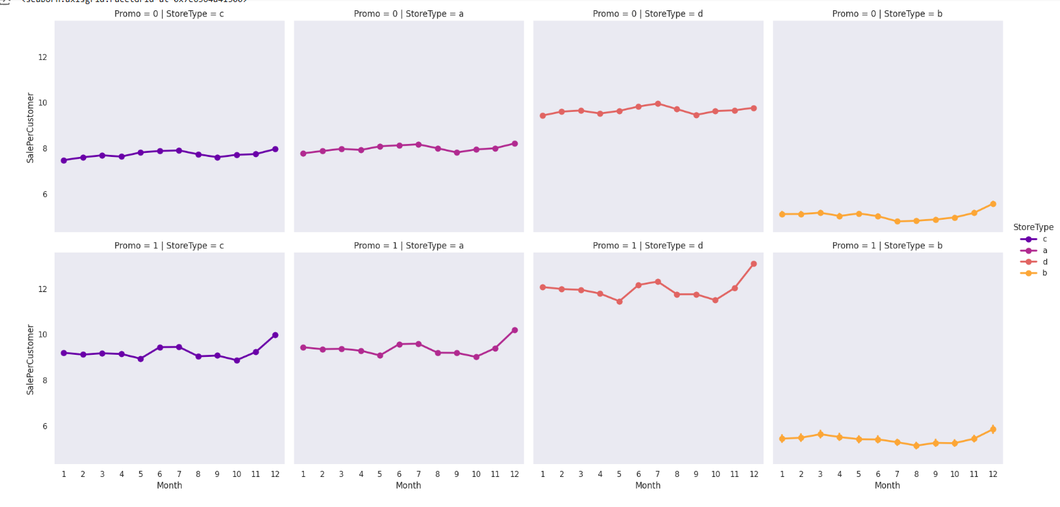
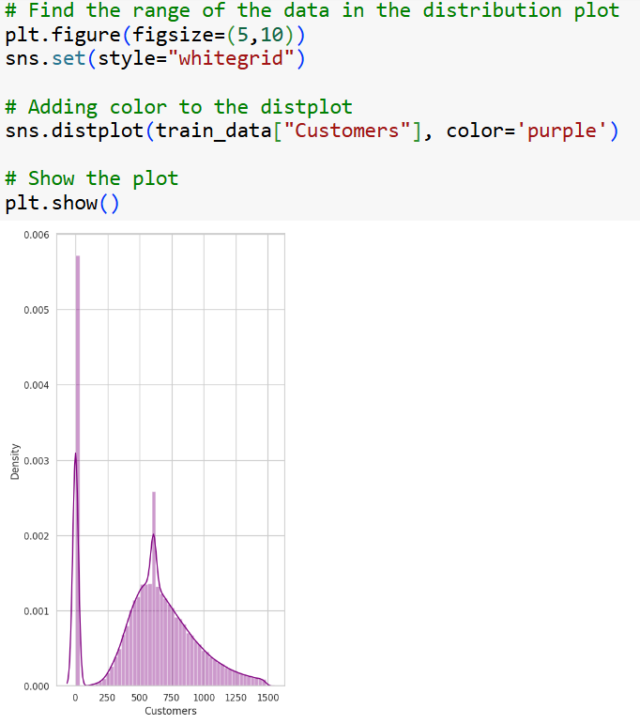
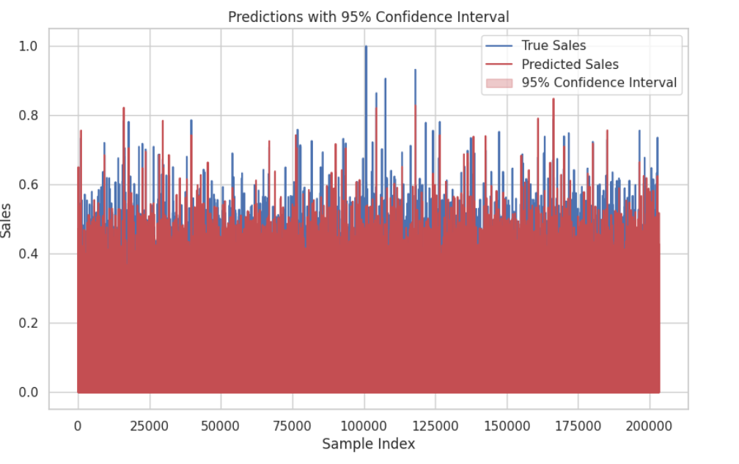
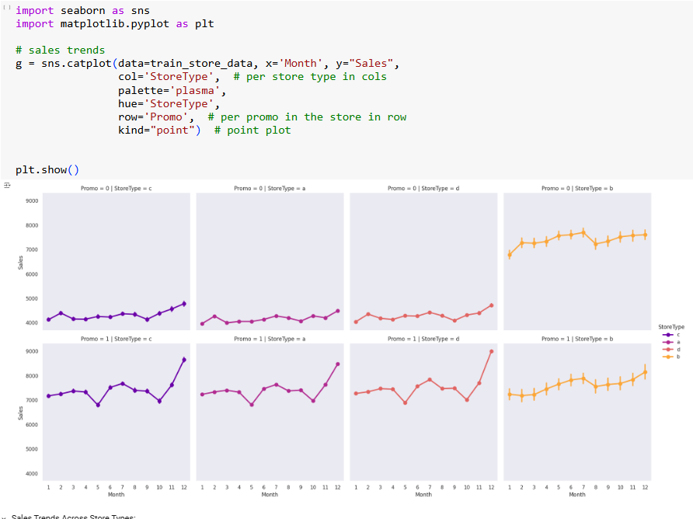
keyfeatures

Slide 6
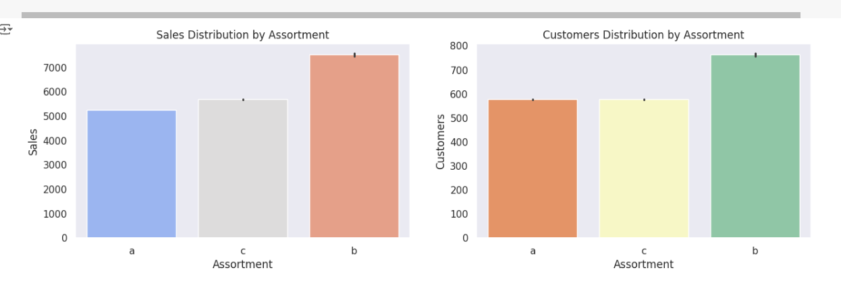
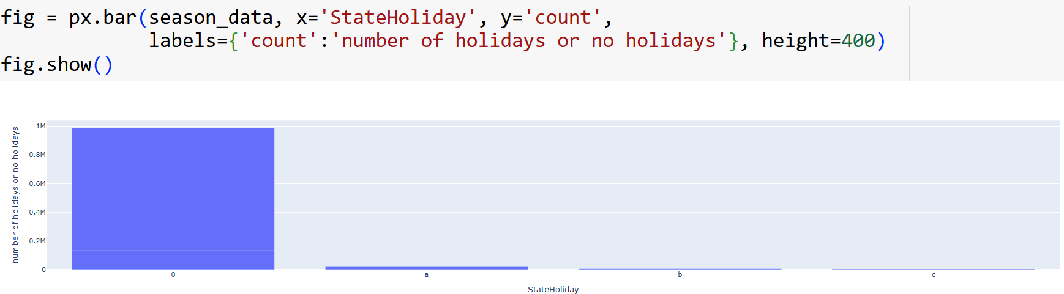
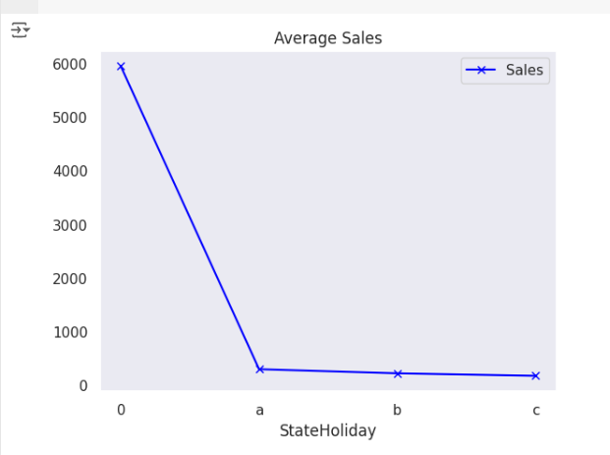
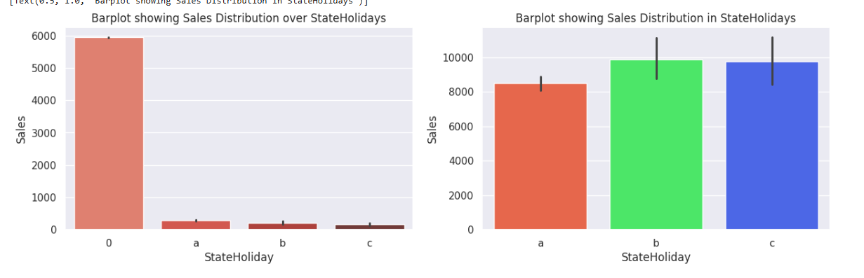
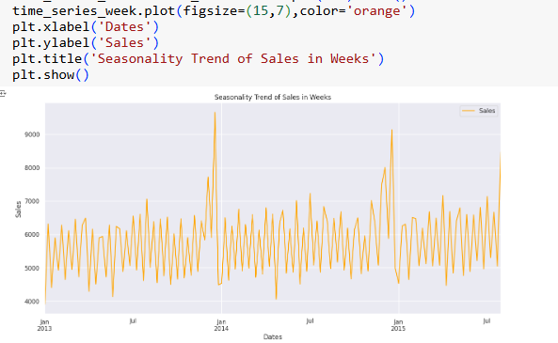
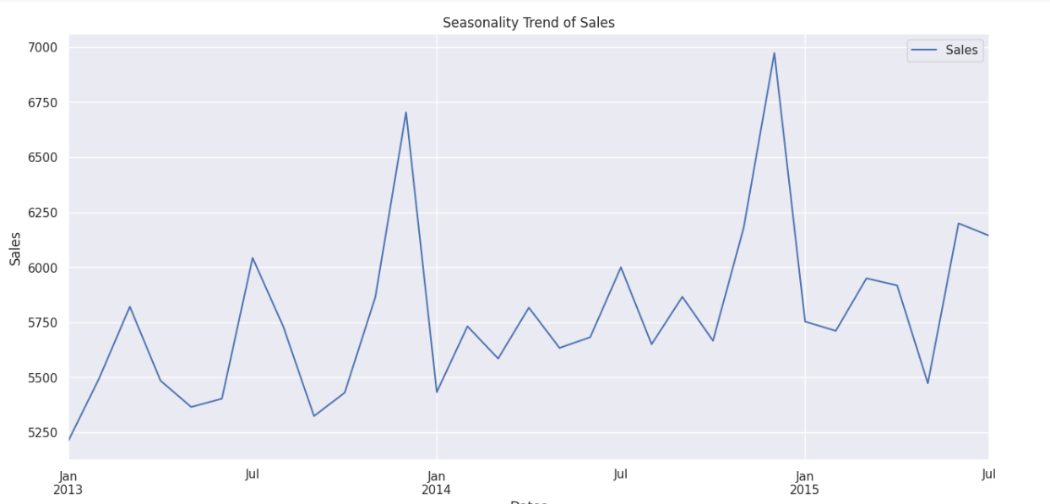
Key features
keyfeatures

Slide 7
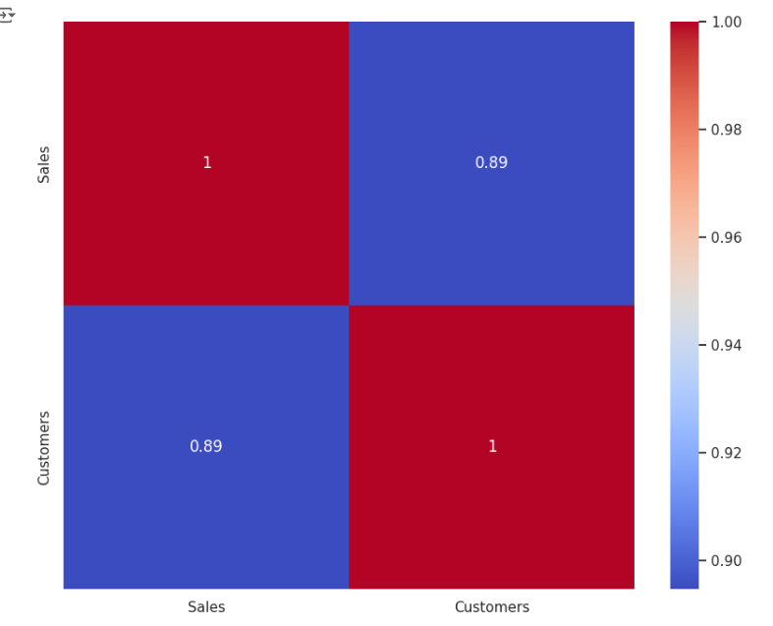
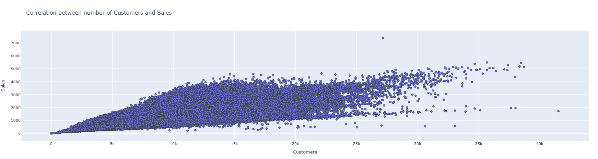
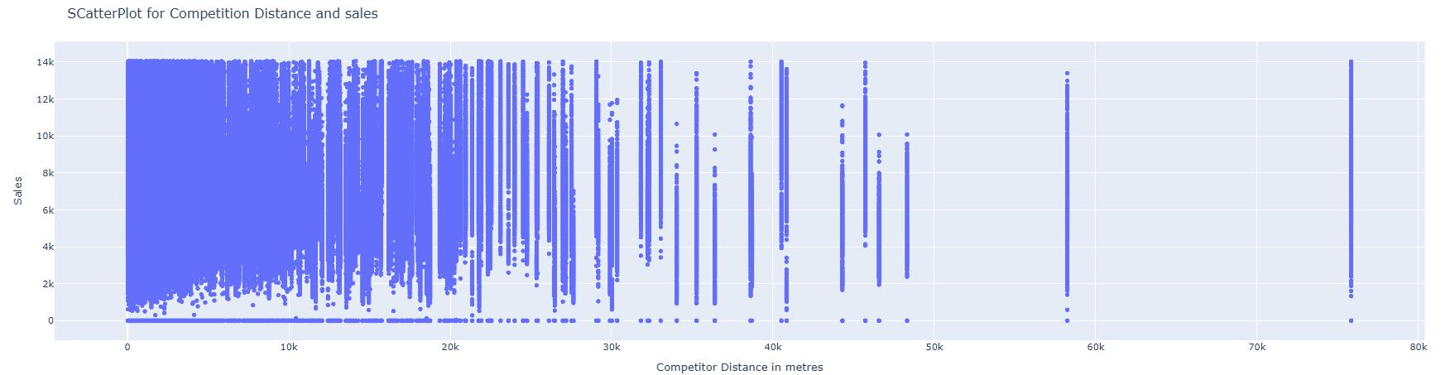
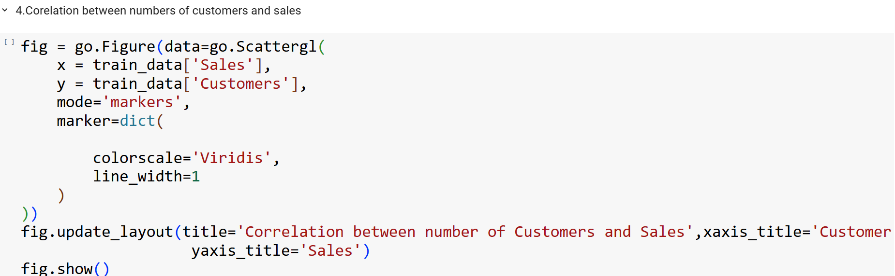
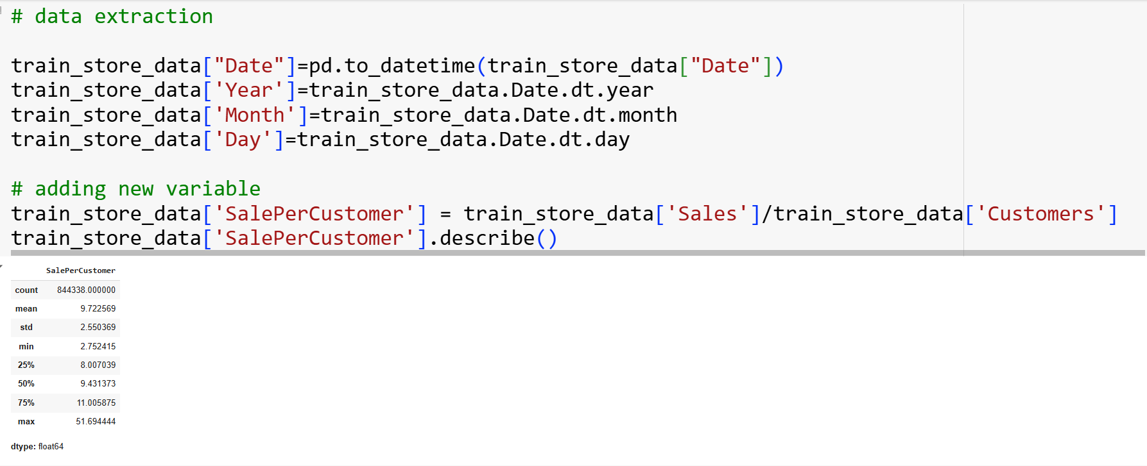
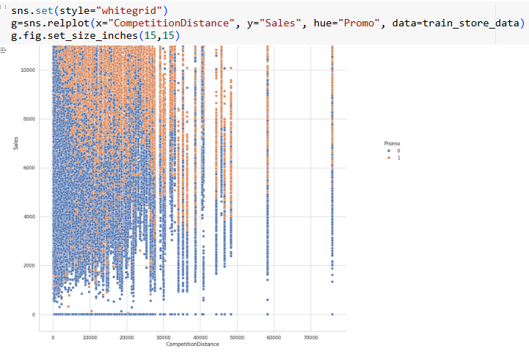
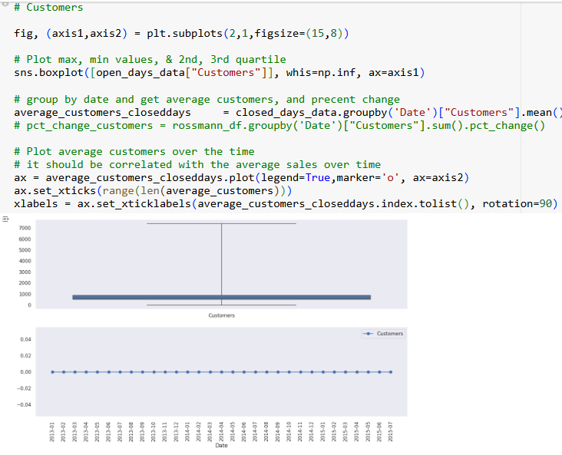
key features
x=train_store_data['CompetitionDistance']
y=train_store_data['Sales']
fig = px.scatter(x=x, y=y)
fig.update_layout(title='SCatterPlot for Competition Distance and sales',xaxis_title='Competitor Distance in metres',
yaxis_title='Sales')
fig.show()

Slide 8
Result and Achievments
Sales prediction accuracy
RandomForestRegressor r2 score=0.8300531249856806
Huber Loss: 0.0007247822638889935
GradientBoostingRegressor r2 score=0.85323671147940
GradientBoosting Regressor(MAE=0.001449564527777987,0.025016699448732443
RMSE=
0.03807314706952903,R-squared)
Huber Loss: 0.0006259098821368999

Slide 9
challenges faced
I face the problem in mlflow and handling NAN value

Slide 10
conclusion
This project uses time-series forecasting and regression techniques to predict pharmaceutical sales based on historical sales data across various stores. By accurately forecasting sales, managers can anticipate demand, manage supply chain logistics, and make promotional decisions more effectively

Slide 11
Thank you

